Slide 1
How can media & interview data be useful to analyse COVID-19 trends in population groups living in vulnerable situations?

Slide 2
The team
Christie Bavelaar
computer science
economics
data visualisation
Kenneth Fargose
engineering
social media analytics
Danielle Rachman
population health management
data analysis
Milou Schamhart
computer science
economics
statistics
Hielke Muizelaar
software development
healthcare applications of CS
Notes:
structural and societal factors such as systemic marginalization, discrimination, stigma, poverty and other intersecting determinants, such as gender, age, immigration status and disability that shape health inequities between and within communitie

Slide 3
Interviewees and advisors
Dr Meriam Ghardallou
medical professional field expert
Samson Yohannes
local knowledge
developer of bulk input tool
Miriam Basajji
expert on CEDAR
in-depth knowledge of project
Prof Mirjam van Reisen
FAIR expert
relationships with local team
Notes:
structural and societal factors such as systemic marginalization, discrimination, stigma, poverty and other intersecting determinants, such as gender, age, immigration status and disability that shape health inequities between and within communitie

Slide 4
Limited surveillance on groups in vulnerable situations
“People living in vulnerable situations are groups and communities at a higher risk for poor health as a result of structural and societal factors” - WHO, 2021
Notes:
structural and societal factors such as systemic marginalization, discrimination, stigma, poverty and other intersecting determinants, such as gender, age, immigration status and disability that shape health inequities between and within communitie

Slide 5
Limited surveillance on groups in vulnerable situations
Lack of early detection
Gaps in care are invisible
No targeted prevention
(WHO, 2021)

Slide 6
⨯
Limited surveillance on groups in vulnerable situations
Poor accessibility to population owing to limited use of services
Reporting challenges
Understanding of health & social services
Financial means
Resources
Skills
(WHO, 2021)

Slide 7
Solution to limited data availability
⨯
Alternative, unconventional data sources may provide insights on COVID-19 trends in groups in vulnerable situations.

Slide 8
Data pipeline for data collection
FAIRification process after the collection
Create excel spreadsheet for inputs
Collect media & interview data
FAIRify data
Bulk input tool Create templates in CEDAR
Align data with values

Slide 9
Missing data in interviews
120
reports
Interviews conducted with migrants and source persons
0.8%
1 instance
How many people known who couldn't access to hospital because of Covid
24%
29 instances
fear of Covid (yes/no)
34%
41 instances
Access to healthcare (good/bad)
41%
50 instances
How many people known with Covid-19 symptoms
9%
58 instances
Name of NGO or other who helped
61%
74 instances
Received help

Slide 10
Missing data in media reports
566
reports
Data was extracted from media related to Covid-19.
0%
0 instances
Number of migrants deaths by COVID -19
0%
0 instances
Number of migrants healed of COVID-19
5%
25 instances
Number of infected migrants
3%
14 instances
Number of deaths when crossing borders
9%
44 instances
Number of migrants in quarantine
14%
68 instances
Number of deaths at sea

Slide 11
Preprocessing the data
Data interpretation
Hard to interpret, not formatted
Multiple languages
Text preprocessing
Typos / misspellings (causing a lot of duplicates)
Inconsistent (i.e. Non numeric values when expecting numeric)
Splitting the data
Multiple values in one cell
Made columns into rows
Notes:
text processing cleaning with templates (typos -> inconsistent )
Multiple values in one cell => one report with different event types but lot of empty data in those columns
We split it into different rows, too many columns in one row
reducing columns, there were too many columns
Hard to interpret the data -> not formatted
made columns into rows

Slide 12
Valuable insights from media & interviews
⨯

Slide 13
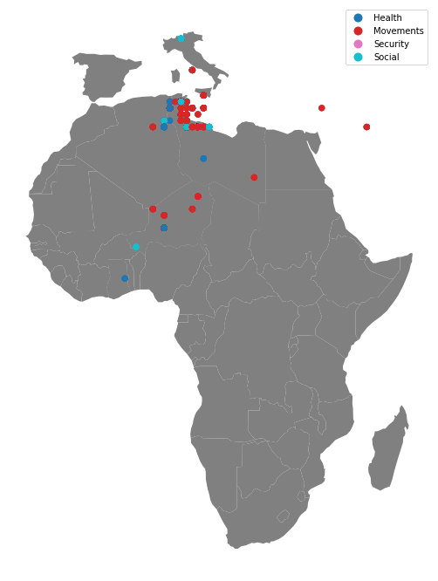
Report events plotted
Most events happened in Tunisia
Most events are movement related
Few events in other countries, like Malta, Italy and Ghana

Slide 14
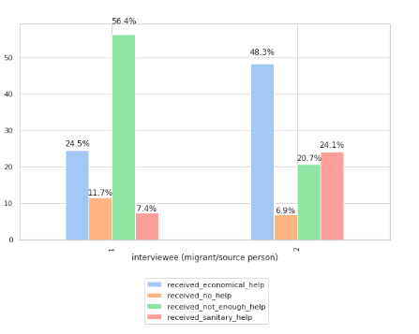
Type of help
48% of the source persons received economical help.
Many of the migrant interviewees reported that they did not receive enough help.
Identifies the current challenges for the migrant population
Notes:
structural and societal factors such as systemic marginalization, discrimination, stigma, poverty and other intersecting determinants, such as gender, age, immigration status and disability that shape health inequities between and within communitie

Slide 15
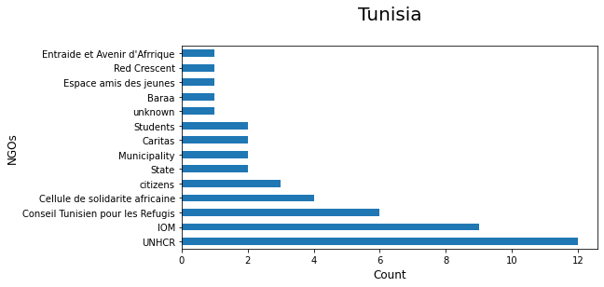
Non-governmental Organisations as point of contact
Assist with identifying the active NGOs in the region who are in contact with people in vulnerable situations.
Partnerships can be formed with the prominent NGOs.
Notes:
structural and societal factors such as systemic marginalization, discrimination, stigma, poverty and other intersecting determinants, such as gender, age, immigration status and disability that shape health inequities between and within communitie

Slide 16
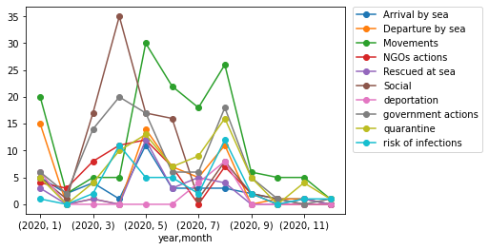
Amount of event types over time
Tunisia
Shows trend for when lockdown happened (March/April)
Shows trend for when restrictions were lifted (July)
Show changes of events over time
Notes:
structural and societal factors such as systemic marginalization, discrimination, stigma, poverty and other intersecting determinants, such as gender, age, immigration status and disability that shape health inequities between and within communitie

Slide 17
Help for those in difficult economic situations
 | Difficult economic situation due to lockdown
 |  | Yes | No
 | Yes, economical | 16 | 1
 | Yes, sanitary | 7 | 0
Received help
Identify which population groups or areas require more assistance and thus, should be a focus for interventions
Notes:
structural and societal factors such as systemic marginalization, discrimination, stigma, poverty and other intersecting determinants, such as gender, age, immigration status and disability that shape health inequities between and within communitie

Slide 18
Recommendations
A proposed process for data collection to improve quality of data and FAIR compliance.

Slide 19
Before data collection
Step 1 | Define goal of data collection
 |  | Identify useful attributes for data collection
Step 2 | Create a template | Split the information over multiple datasets to prevent duplication. Example: cities with their coordinates need to be defined only once
 |  | Standardize input values Example: use constraints like, no free text
Step 3 | Consult the analyst to confirm that the template is useful for analysis
Step 4 | Describe columns in detailed metadata

Slide 20
During data collection
Use templates when collecting input
Do not add columns during data collection. If information is useful create a separated (linked) dataset.
Verify if your collected information serves the goal of your investigation.

Slide 21
After data collection
Remove unused parts of the template
Example: Unused columns or values
Verify if all input is in a correct format
Example: Durations all in hours or minutes
Verify if all input values are reasonable

Slide 22
Media & interview data can be useful to analyse COVID-19 trends in population groups living in vulnerable situations.

